Slide 1
Project showcase

Slide 2
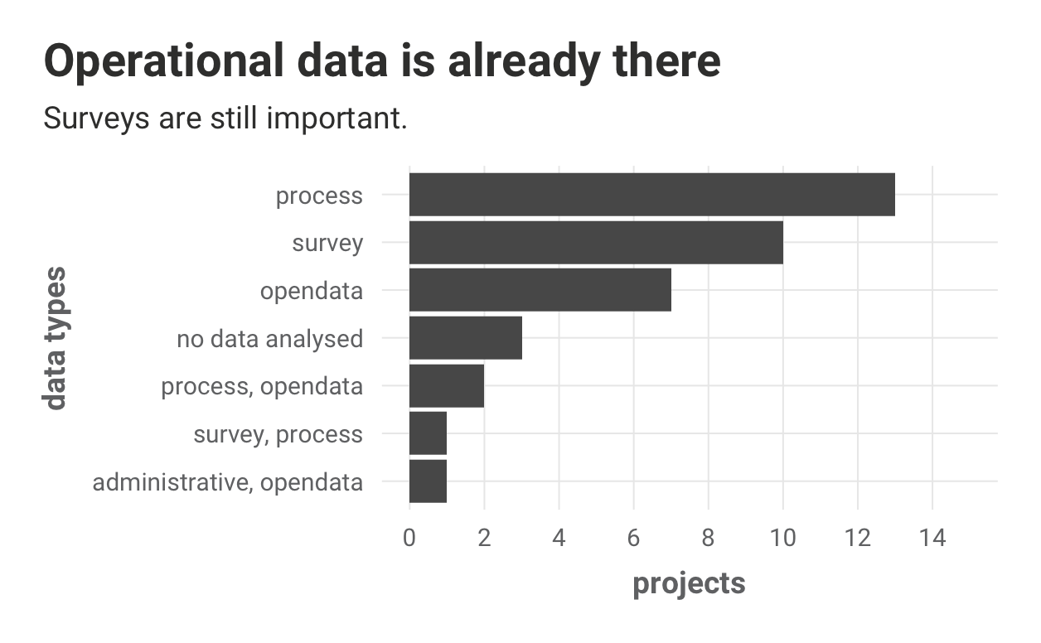
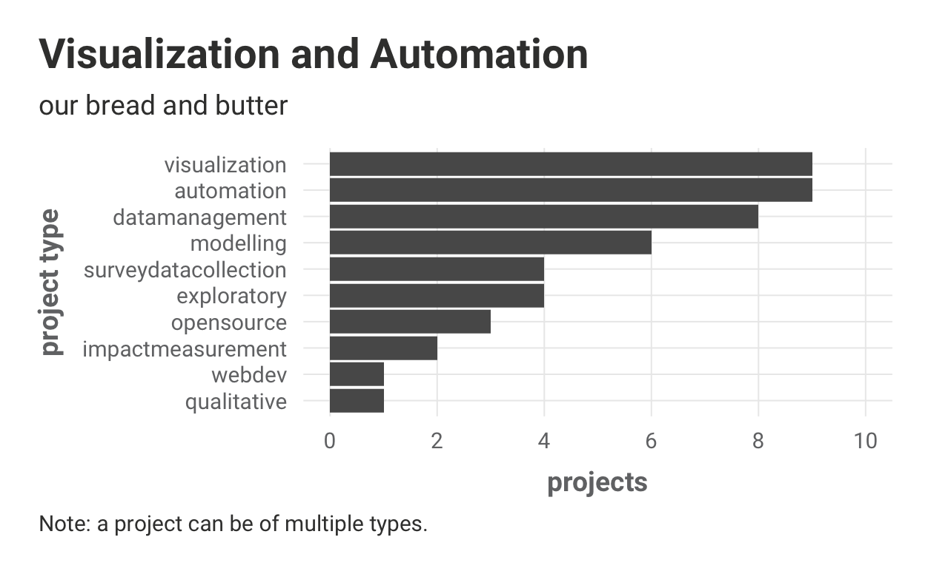
CorrelAid projects in 2021
>150 team members
...in…
37 projects

Slide 3
Project Showcase
10 projects in 3 sections
Communicating your work with data visualization
Managing data and automating work
Getting insights into your data: Analysis and modelling
each ~10 minutes lightning talks and ~10 minutes Q&A

Slide 4
Communicating your work with data visualization
Mare Liberum: Data visualizations to bring attention to illegal pushbacks
Hacklab Developer Census
Addressing deforestation in Kosovo

Slide 5

Mare Liberum
Data visualizations to bring attention to illegal pushbacks

Slide 6

The Problem
Human Rights Violations in the Aegean Sea
The NGO monitors and documents the situation to inform the public
The Goal: Better communication through visualization
→ Set up a database to store and access data
→ Use sophisticated visualizations for an annual report and other social media activities

Slide 7

The Data and the Solution
More than 300 documented cases of pushbacks
1 Person in the NGO was familiar with R
After cleaning and wrangling the data we presented our findings
→ Providing visualizations for their report
→ Proposing a more concise way of collecting and storing data for the future

Slide 8
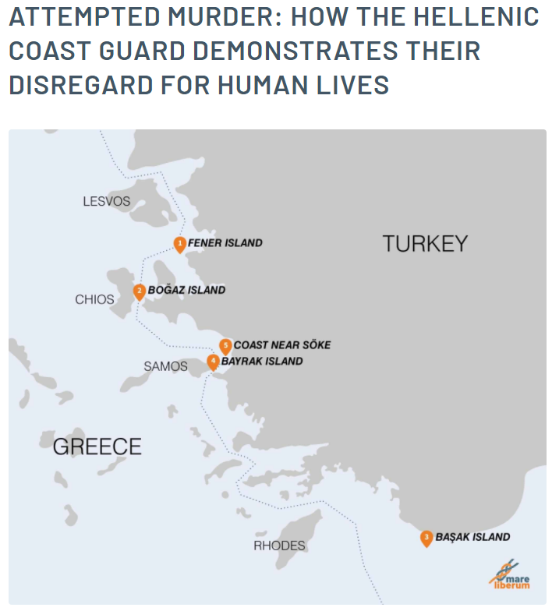
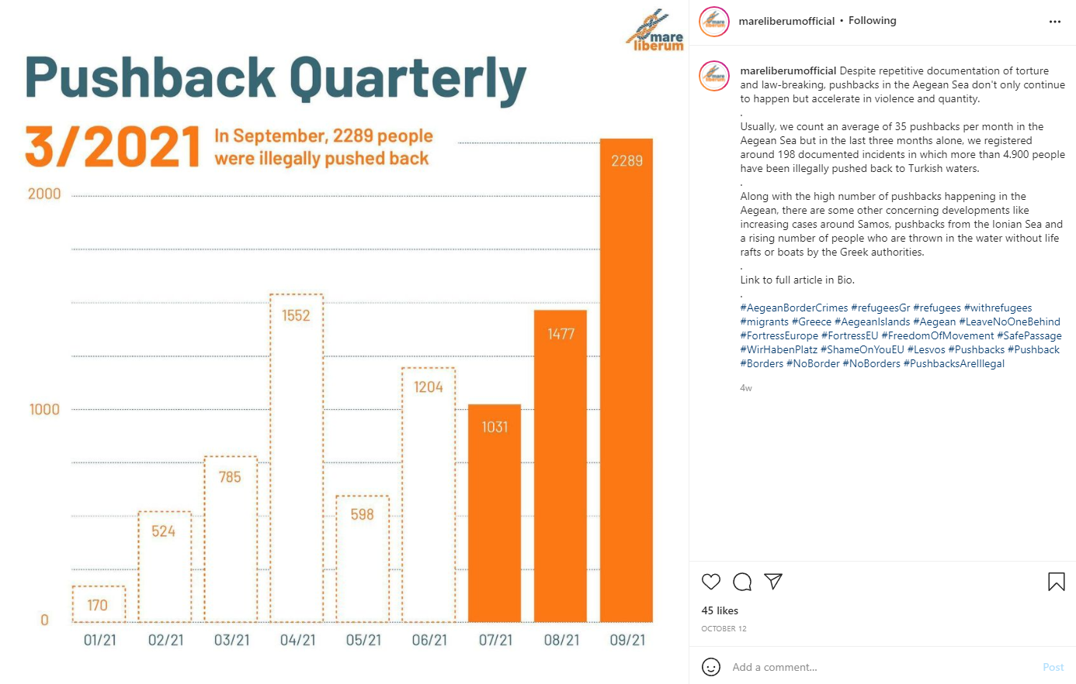
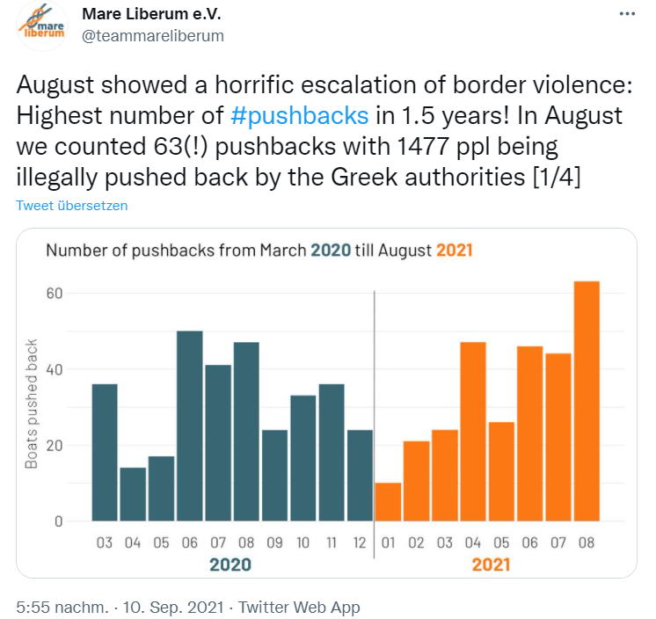
After the project...

Slide 9
Hacklab Developer Census
Visualizing the first survey of people who code in Ghana
Vivien Barchet, Sofia Thai, François Delavy, Priyanka Gagneja

Slide 10

The NPO
Hacklab Foundation prepares/educates youth in Ghana for future jobs in technology (Bootcamps, Hackathons, Mentorships etc.)
Hacklab Developer Census: Survey about Ghanaian developer scene
Audience: Ghanaian coders community (students, NPOs, …)
Goal: Learn more about developer scene in Ghana

Slide 11
Our Task
Create online visual report of the Hacklab Developer Census on their website
Give insights about characteristics, preferred tools, and career backgrounds of Ghanaian developers

Slide 12
How We Did It
Online interactive data report
Standalone RMarkdown HTML
Custom CSS theme
Reproducible

Slide 13
Learn More About the Project
Explore the report https://hacklabfoundation.org/Developer-Census-2020-Report.html
Code https://github.com/CorrelAid/hacklab-foundation
Visit the Hacklab Foundation https://hacklabfoundation.org/

Slide 14


#MoseMerrMalin
Joint efforts to address the deforestation issue in Kosovo.

Slide 15



The Team
ALICK
BIRD
FEDERICO
FRANCIAMORE
JORDY
DE YONG
MEHRZAD KARAMI, ANDREW SUTJAHJO - INDIRA KARTALLOZI, RINA FETAHAJ - FARUK FONIQI

Slide 16
The Problem
The Goals
Validate Geo-spatial
results
Deforestation
Validation of data retrieved
Corruption/no transparency
Create and spread awareness
Tell a story

Slide 17





The Data
EO Data

Slide 18
The Solution
Validation of data using different sources (GFW)
Creation of a story line with the help of Ashraf Ramzy MasterStory®
Development of an online platform directed to two main users, including:
Use of maps and data
Appealing graphics
Touch points

Slide 19
Demo
https://www.slkosova.org/mosemerrmalin-welcome

Slide 20
Managing data and automating work
Kulturen im Kiez
Science on Stage
Citizens for Europe Report Automation

Slide 21

Kulturen im Kiez
presented by Daniela Mondorf

Slide 22
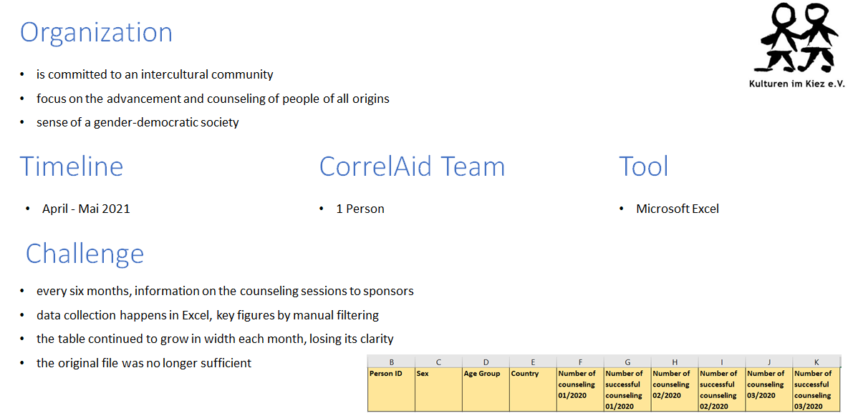
Kulturen im Kiez
Organization
is committed to an intercultural community
focus on the advancement and counseling of people of all origins
sense of a gender-democratic society
Challenge
every six months, information on the counselling sessions to sponsors
data collection happens in Excel, key figures by manual filtering
the table continued to grow in width each month, losing its clarity
the original file was no longer sufficient
Timeline
April - Mai 2021
CorrelAid Team
1 Person
Tool
Microsoft Excel

Slide 23
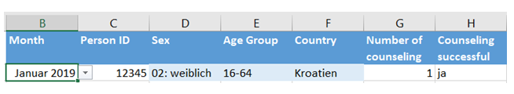
Kulturen im Kiez
Solution
restructuring the Excel file, transforming month from column to row
the spreadsheet grows downward instead of outward
automated input functions further simplify data entry
addition of predefined pivot reports in separate spreadsheets for common questions
Impact
quickly pull relevant key figures from data collection file and predefined reports
time saved during data entry by automated field entry
new structure for long term clarity

Slide 24
Science on Stage
Team: Angela Jones, Florian Kaiser, Hauke Roggenkamp, Malte Jeschonneck, Linn von Engelbrechten, Tim Fangmeyer
Science on Stage: Daniela Neumann

Slide 25

The Goal
Help Science on Stage automate the data collection and cleaning process
Choose an easy-to-produce and readable format to present the results

Slide 26
The Problem: Combine Data From Different Sources
Matomo
Excel
Clickmeeting
Surveymonkey
> Create Parametrized Reports

Slide 27
Lessons Learned
Even if there’s no outside pressure, set and keep your own deadline
Character encoding is evil
Expect that every API has its quirks and limitations

Slide 28
Citizens for Europe
Report Automation
Team: Christine Hedde-von Westernhagen, Ruth Kessler, Simon Schölzel, Philipp Sebök, Allyson da Silva

Slide 29

The Setup
survey organizations and communities about diversity, work climate, measures supporting inclusion
standardized report template

Slide 30
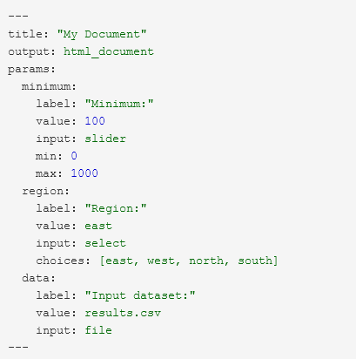
Parameterized Reports
Challenges:
organization-specific questions
multiple output languages
inclusion of elements depending on audience
report elements created by multiple (non-tech) people
Need a more flexible and collaboration friendly approach.

Slide 31

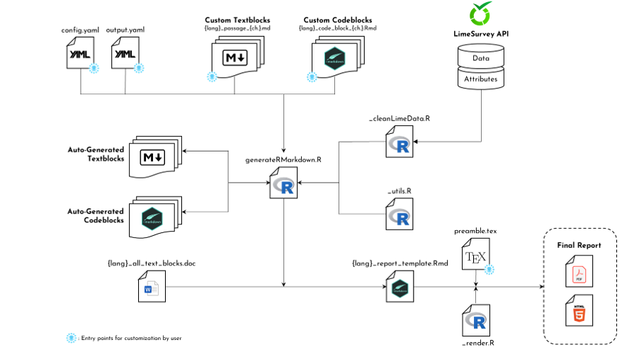
Our Solution
Workflow Inputs:
Config files
Custom/auto-generated text and code files
Survey data
Various R-scripts
Workflow Outputs:
.Rmd report template
PDF-/HTML- report (language-specific)

Slide 32
Q&A:
Managing data and automating work
Kulturen im Kiez
Science on Stage
Citizens for Europe Report Automation

Slide 33
Getting insights into your data: Analysis and modelling
CargoRocket: Classification of Road Quality Using Crowd-Sourced Images
The impact of Voting Advice Applications on Local Politics
Citizen Science Dynamics
G-moji

Slide 34
Komunat
The impact of Voting Advice Applications On Local Politics

Slide 35
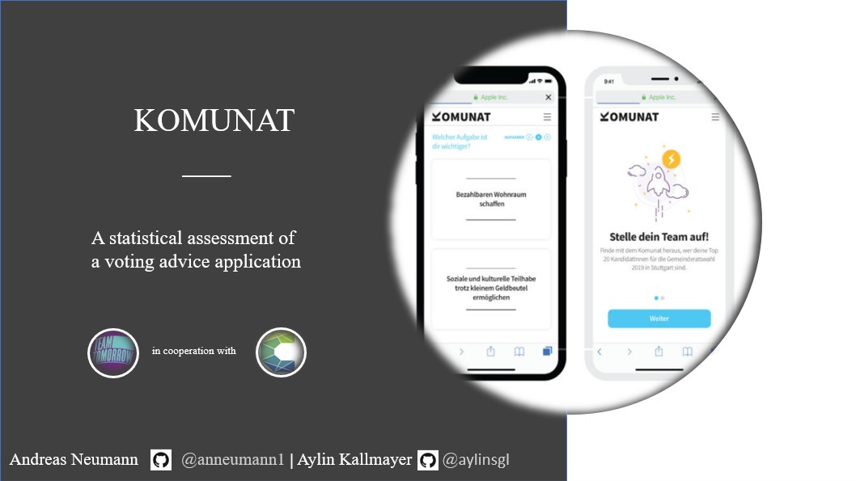

Slide 36
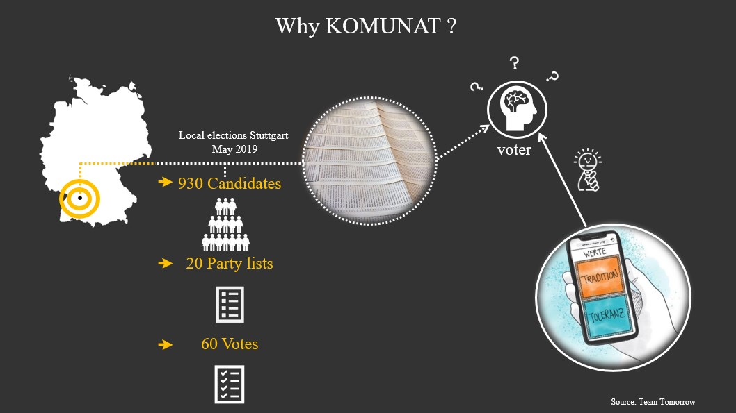

Slide 37
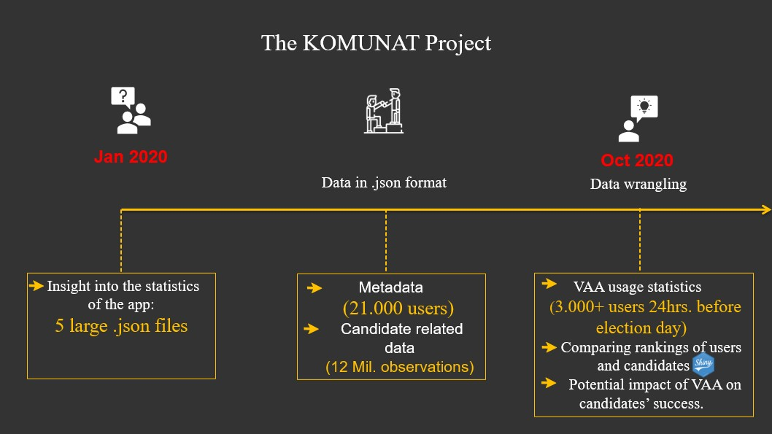

Slide 38
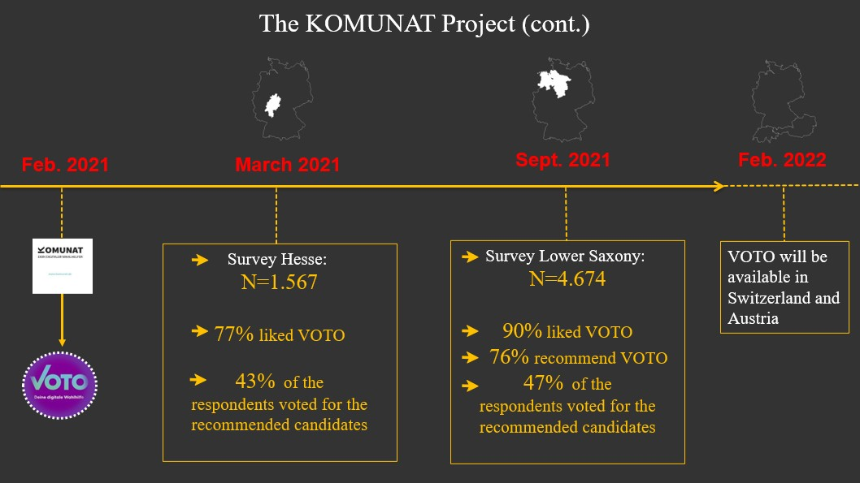

Slide 39
Citizen Science Dynamics
User Behavior on the iNaturalist Platform

Slide 40
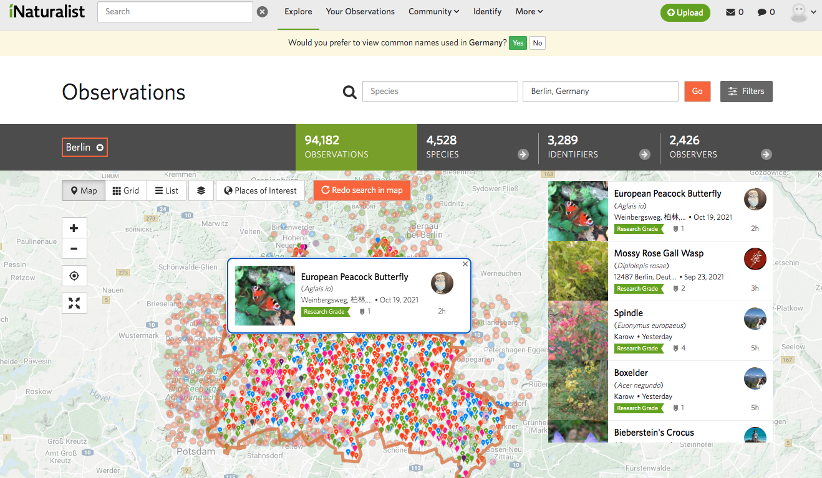




iNaturalist
Users can submit observations of animals, plants, etc.
That’s a
bird!
Other users can aid in identifying the species observations
We downloaded a dataset of observations.

Slide 41
Our project
Our approach
Let’s goooo!
Goal: Find interesting stuff!
Research Questions
How does the user base change over time?
What types of users are there?
What makes users stay/leave?
Where are observations made?
….
General Statistics
Spatial Analysis
Network Science
Time series
User clustering
Deep Neural Networks??

Slide 42
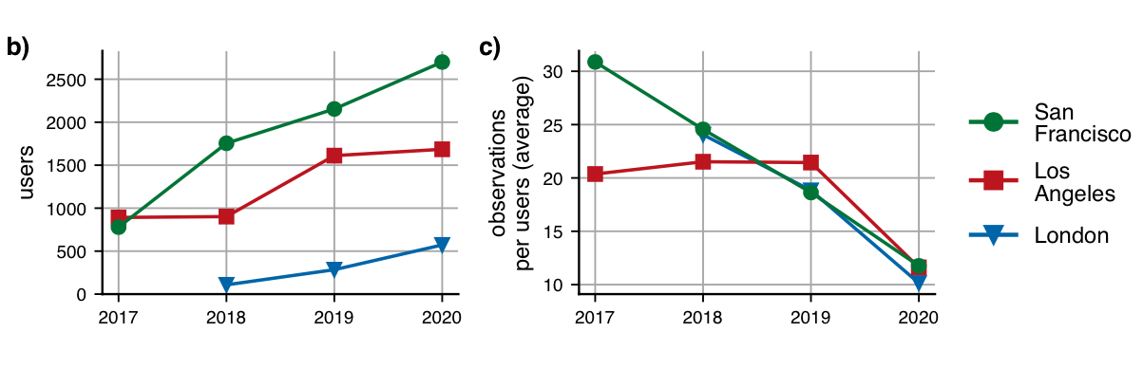
General trends
Number of Users
Observations per user
The number of users increased over the years, but new users make fewer observations.

Slide 43
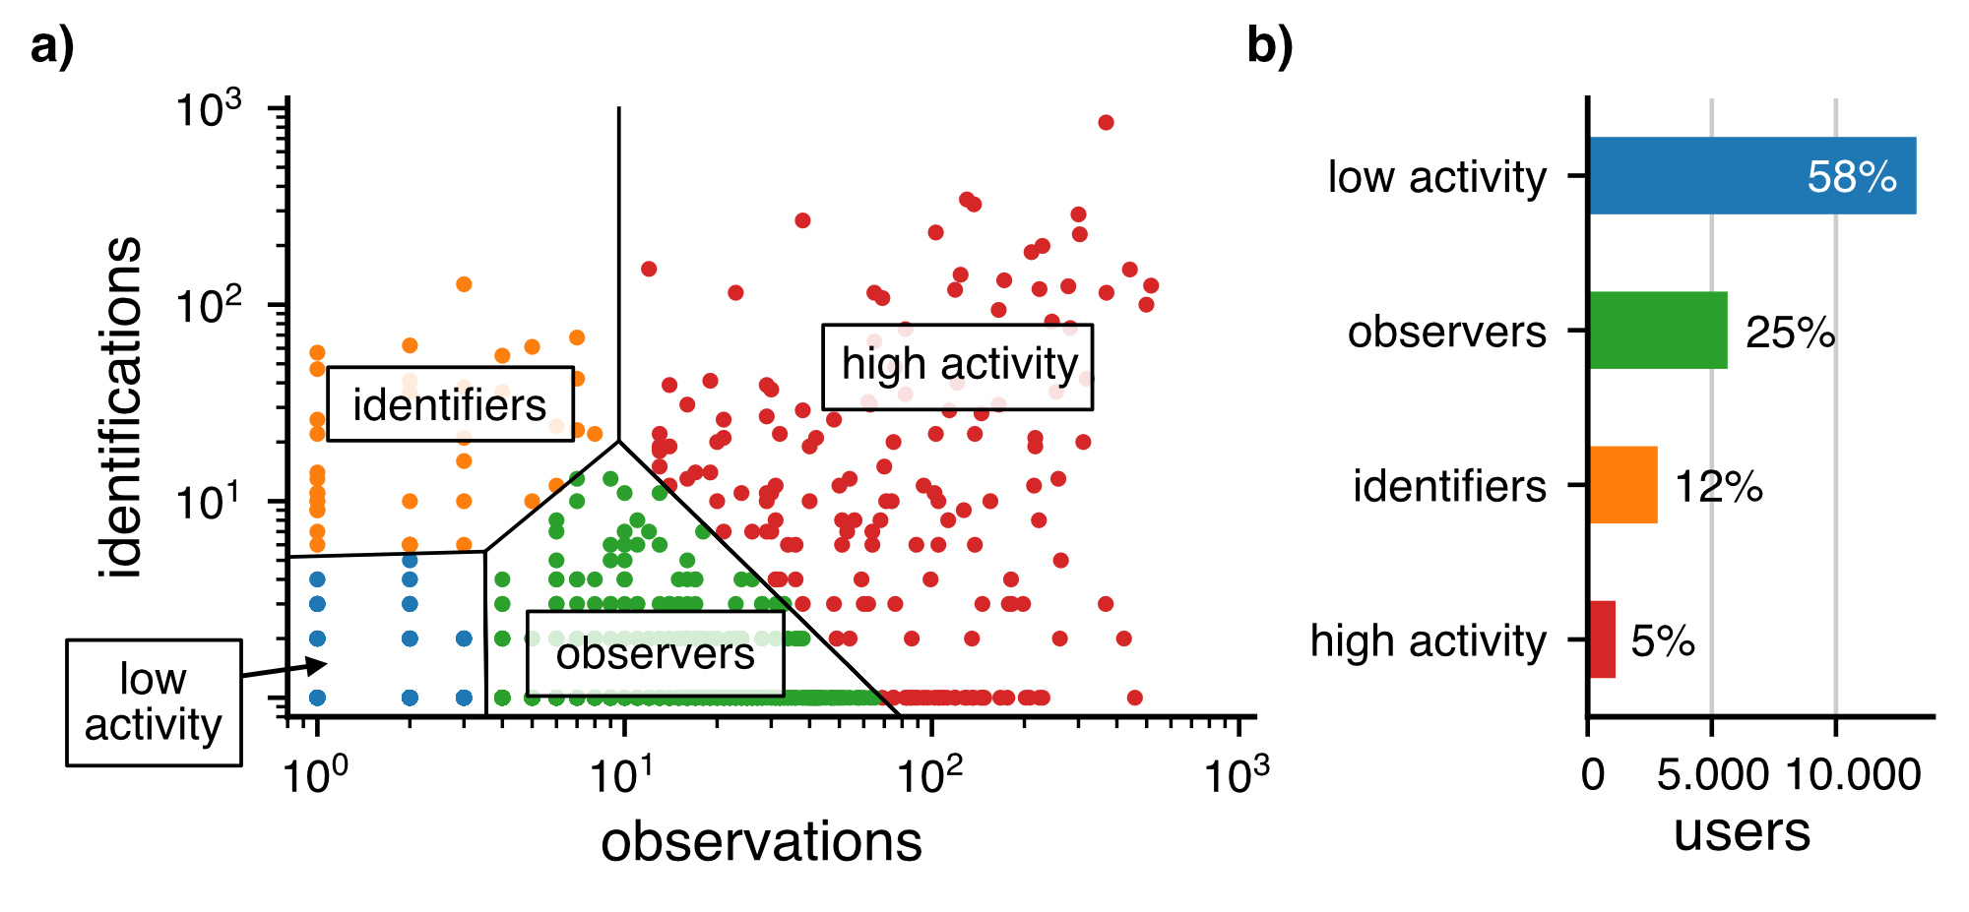
We identified four clusters of users
Most users are low-activity users, contributing few observations and identifications.
Only a small fraction are high-activity.

Slide 44
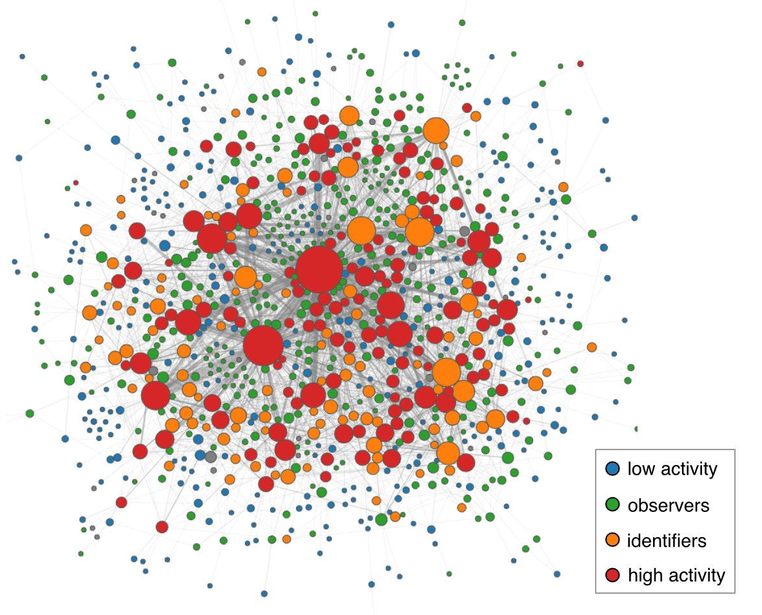
The social network of users
London 2018

Slide 45
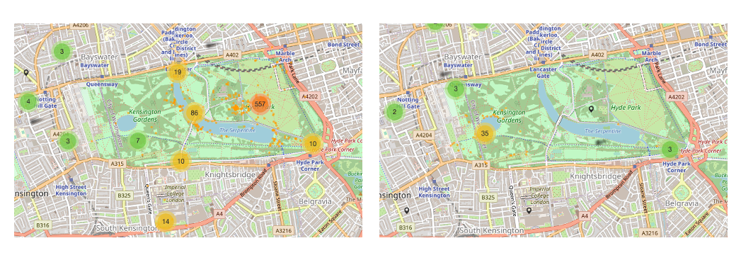
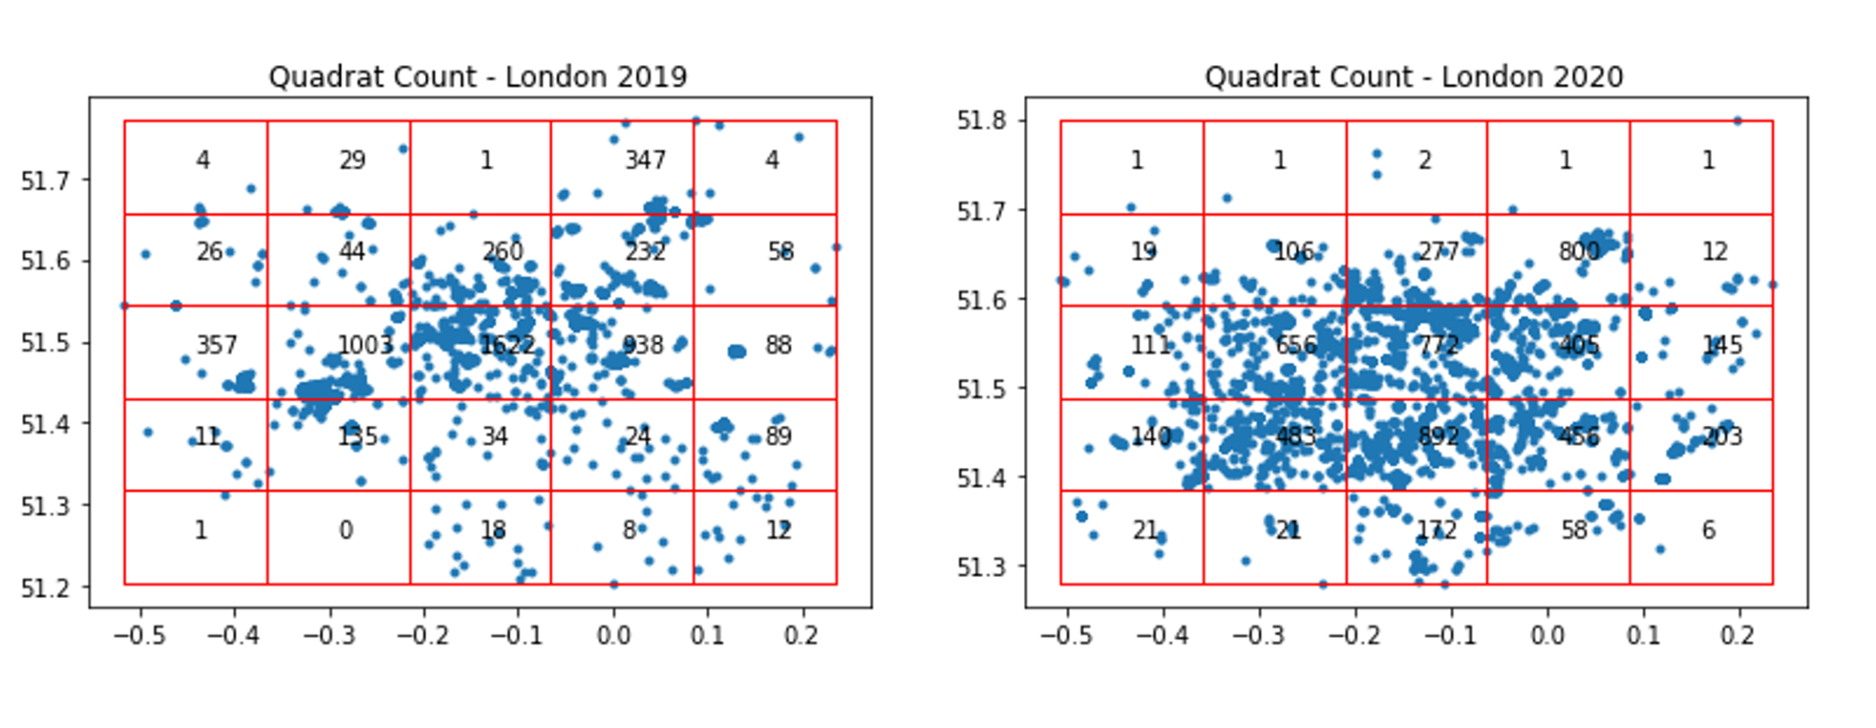
Spatial distribution
of observations
2019
2020
London Hyde Park
In 2020, fewer observations were made in the city center
London Overall
More observations were made at the outskirts of London.

Slide 46
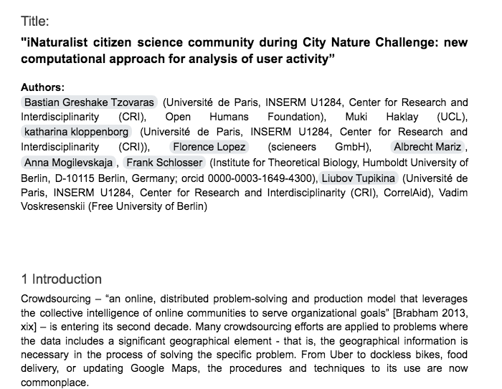
We’re writing a paper!

Slide 47
Lessons Learned
Complex datasets contain a lot of insights
Exploratory data analysis eats a lot of time
→ Formulate goals/research questions
→ Focus
→ Communicate

Slide 48
G-Moji
Team 1: Bart Vollebergh, Ruoxuan Guo, Andrew Sutjahjo, Peter Mohr
Team 2: Alexis Gillet, Maud Grol, Silvan Hornstein, Nino van Halem & Wally (Toh Wen Qiang)

Slide 49
Problem: Evaluate feasibility of predicting emoji input for youth mental health app
Correlaid Team #1
Built ML pipeline for emoji prediction:
Features: Baseline survey data
Correlaid Team #2
Checked app attrition to see whether it is reaching the right people
Continued building ML pipeline:
Add benchmark models
Add phone-related features + past emojis
Treat data as time series
Explainable model for feature importance
Reviewed problem definition

Slide 50
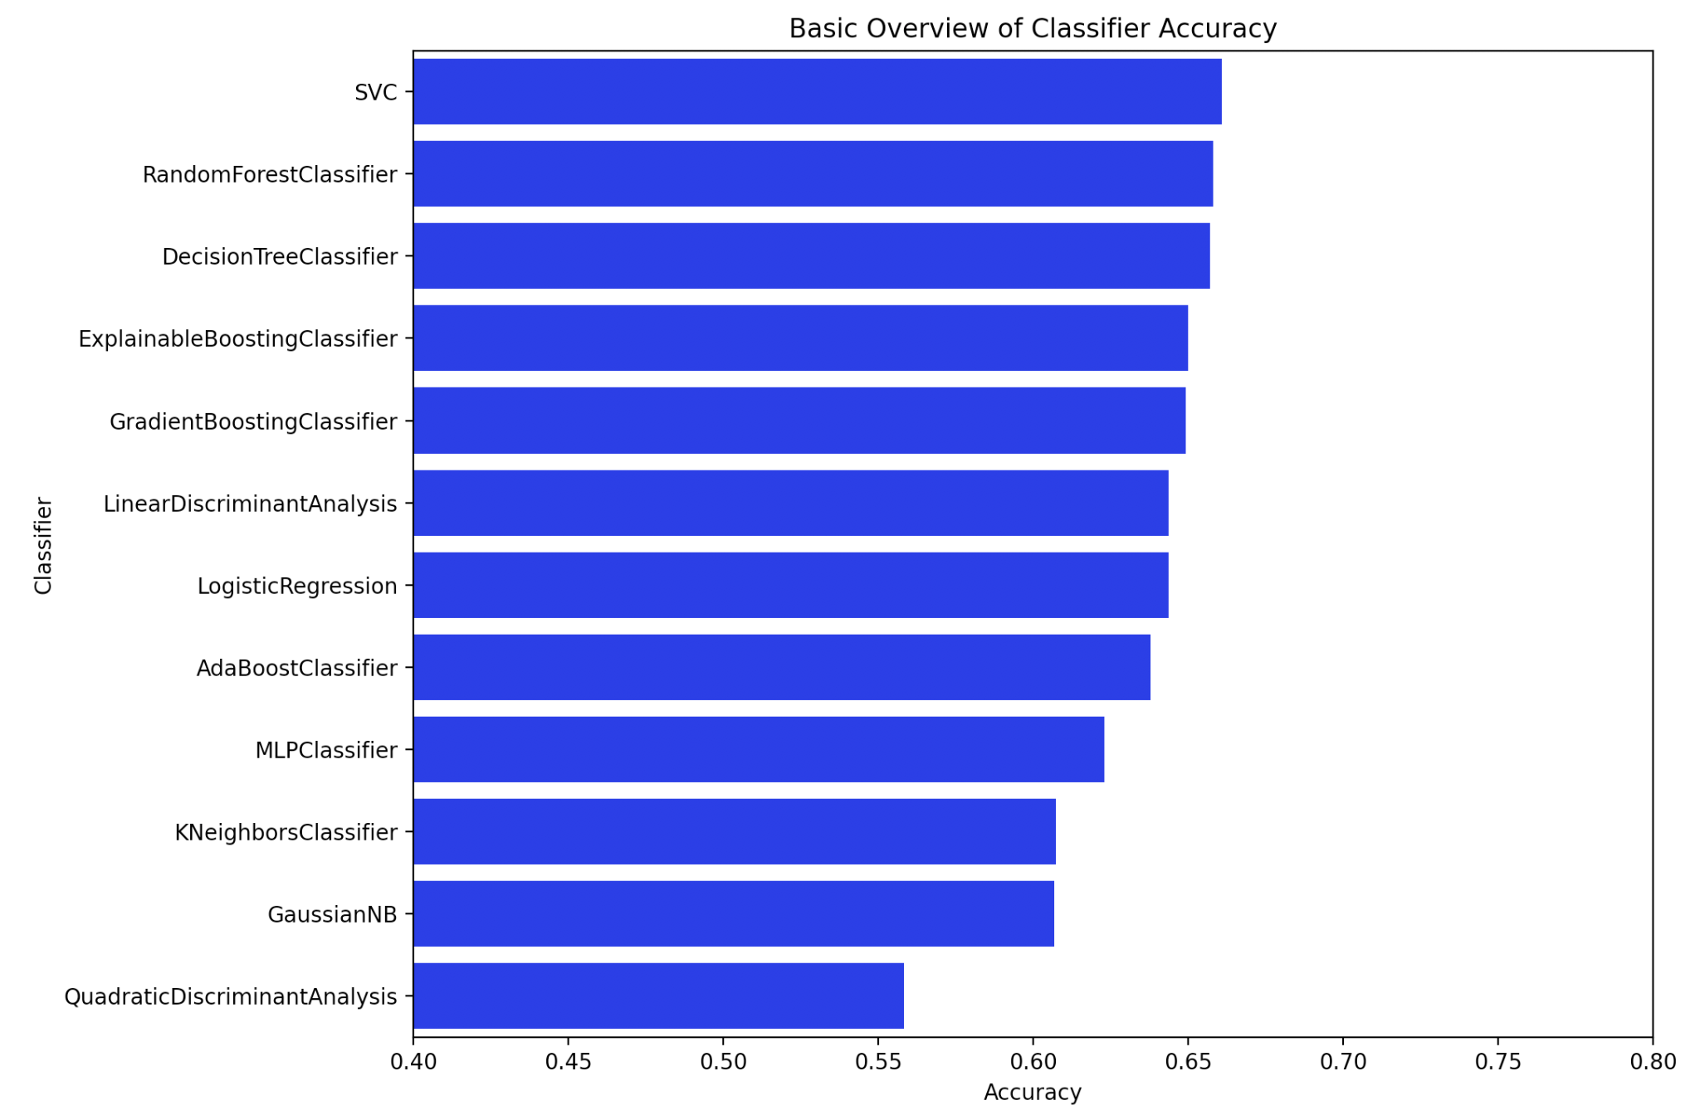
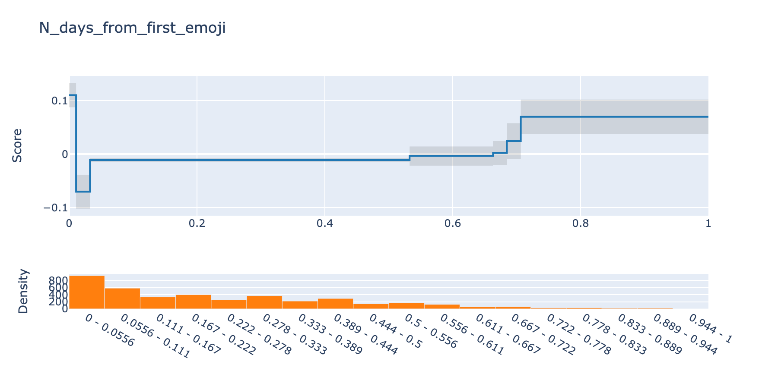
Results and recommendations
→ Not much gain from ML over benchmark
→ Very poor data availability from phone sensors
→ Literature has similar sample sizes, more complete data per individual, yet comparable prediction performance
65%
More sad emojis drop out near the start
Best benchmark model accuracy
64.8%
More sad emojis remain

Slide 51
Q&A
Getting insights into your data: Analysis and modelling
CargoRocket: Classification of Road Quality Using Crowd-Sourced Images
The impact of Voting Advice Applications on Local Politics
Citizen Science Dynamics
G-moji

Slide 52
Thank you!
Have a project idea (NPO or without NPO)? Write me at projects@correlaid.org !

